Slide 1
Predicting Term
Deposit Subscription
How can we improve future marketing campaigns?
Group Member: Victor Vu - Theodore Willems - Andrew Martinez – Daniel Russotto - Celine Khoury - Tomas Tello - Christine Utendorf

Slide 2
We followed a 5-steps approach to classify customers
1
2
3
4
5
Business Context
Data preparation & exploration
Baseline Model
Feature engineering
Final model

Slide 3
We followed a 5-steps approach to classify customers
1
2
3
4
5
Business Context
Data preparation & exploration
Baseline Model
Feature engineering
Final model

Slide 4



Our task is to predict if client subsribe to the term deposit. This allows us to target customer with high success rate and improve marketing effectiveness
Background
Task
Objective
Term deposit is a deposit that a financial institution offers with a fixed rate in which your money will be returned back at a specific maturity time
Using information of last marketing campaigns to Predict if the client will subscribe (yes/no) a term deposit
Identify customer with high success rate to Improve the effectiveness of future marketing campaigns

Slide 5
We followed a 5-steps approach to classify customers
1
2
3
4
5
Business Context
Data preparation & exploration
Baseline Model
Feature engineering
Final model

Slide 6

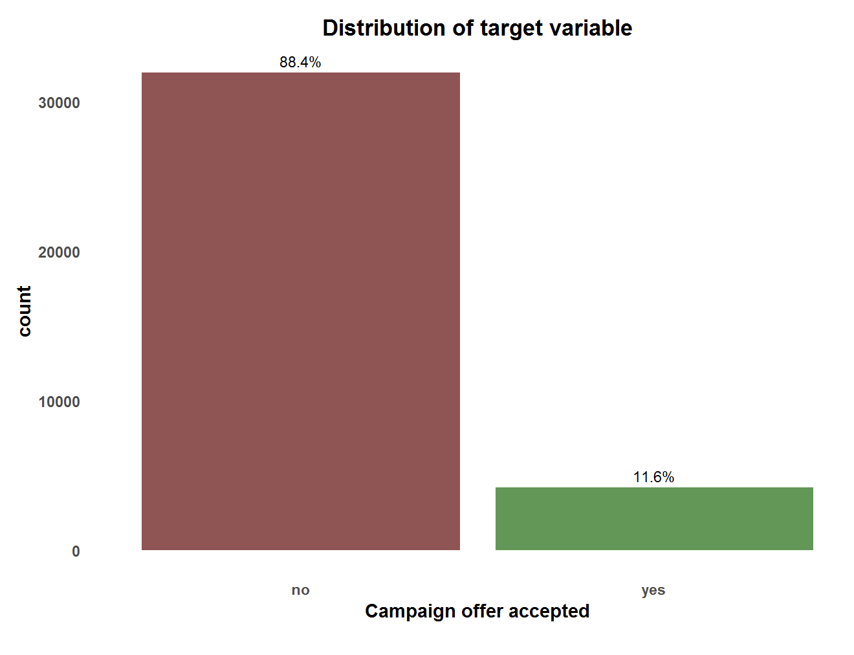

Distribution of Target variable is highly unbalanced with 88% of the label being negative. This raises the need for resampling to ensure modeling performance.
Distribution of the target variable
Unbalanced target variable – 1 to 9
Resampling needed
Monitor AUC + Sensitivity + Precision
Yes = positive class

Slide 7
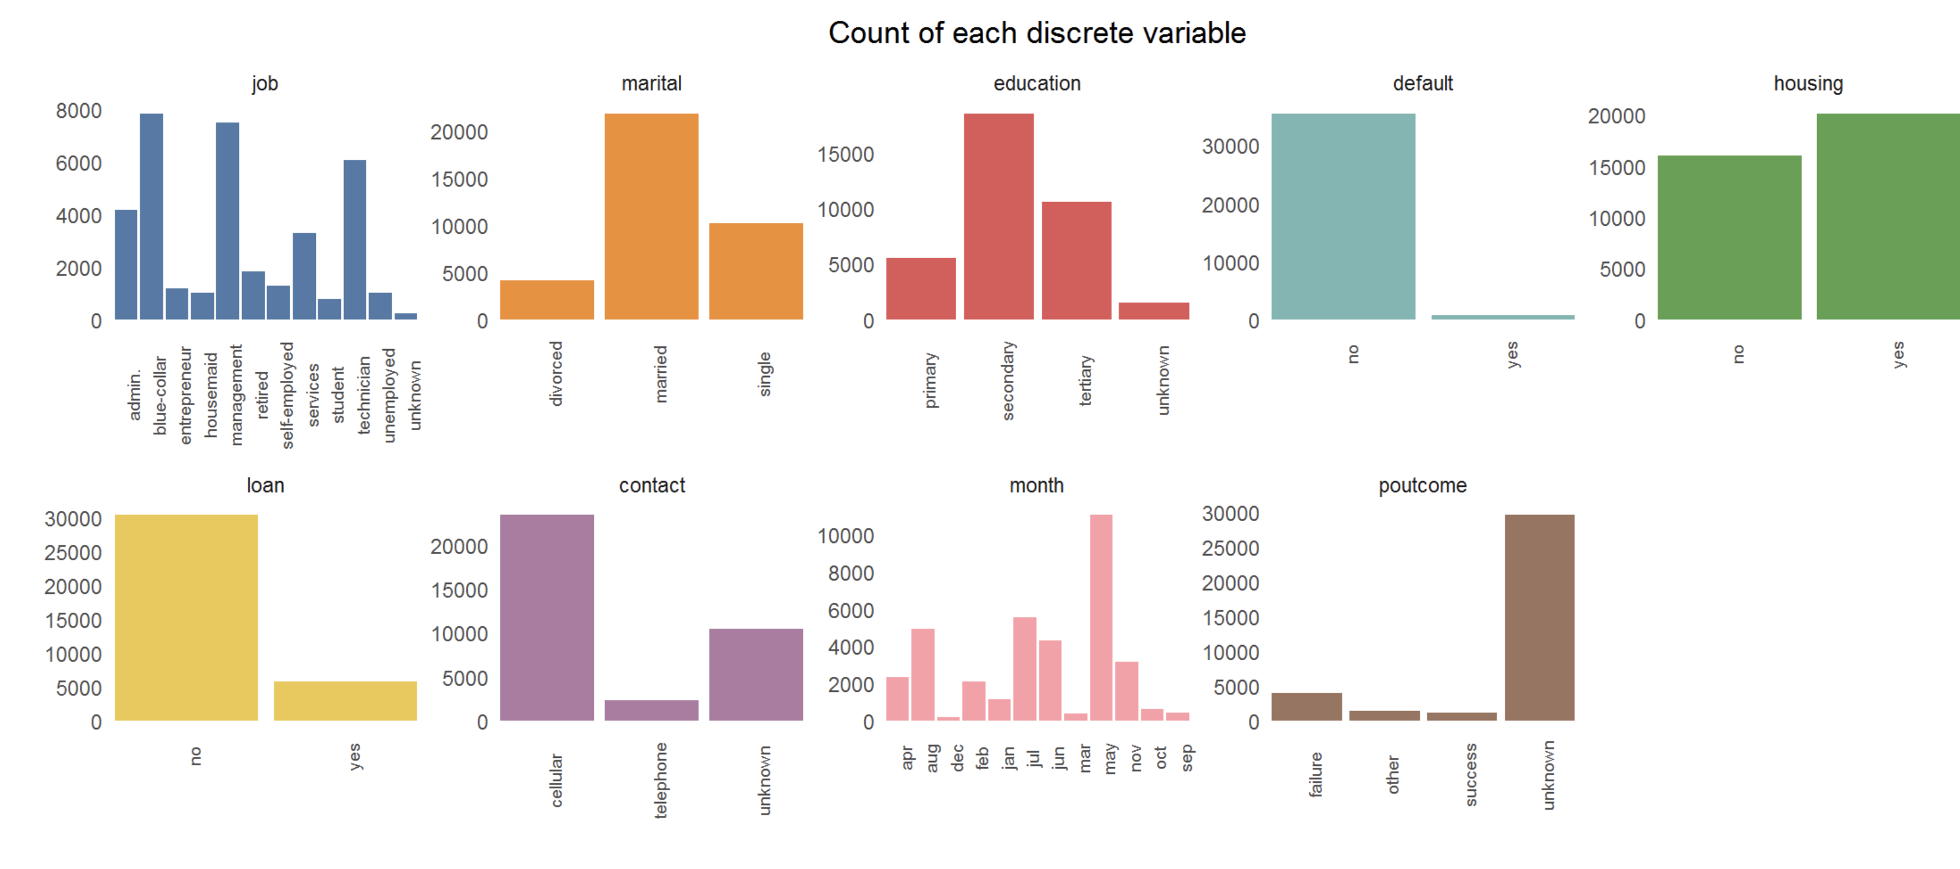
Count of category within factor variables are highly unbalanced especially for “default”, “poutcome” and “loan”.

Slide 8
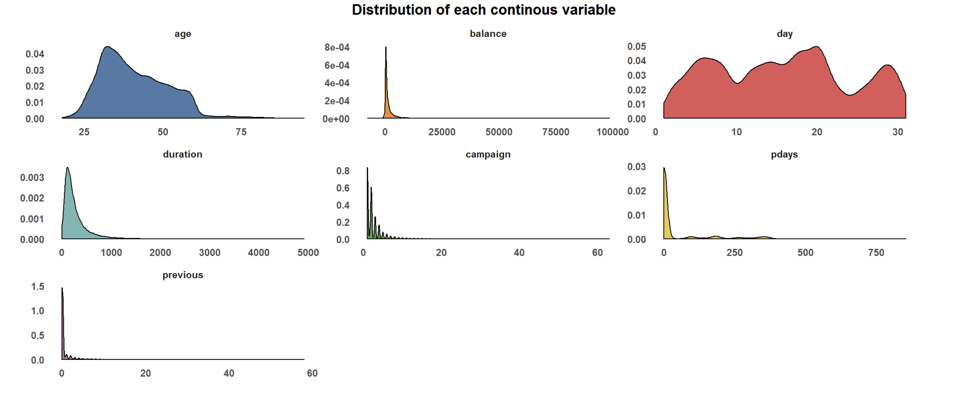
Distribution of continuous variables are highly skewed to the right. This pattern also repeats for the test set.
Train and test distribution have similar distribution

Slide 9



While the data is clean with no NAs, high skewness in variable distributions shows that there are significant outliers.
NA
Outliers

Slide 10
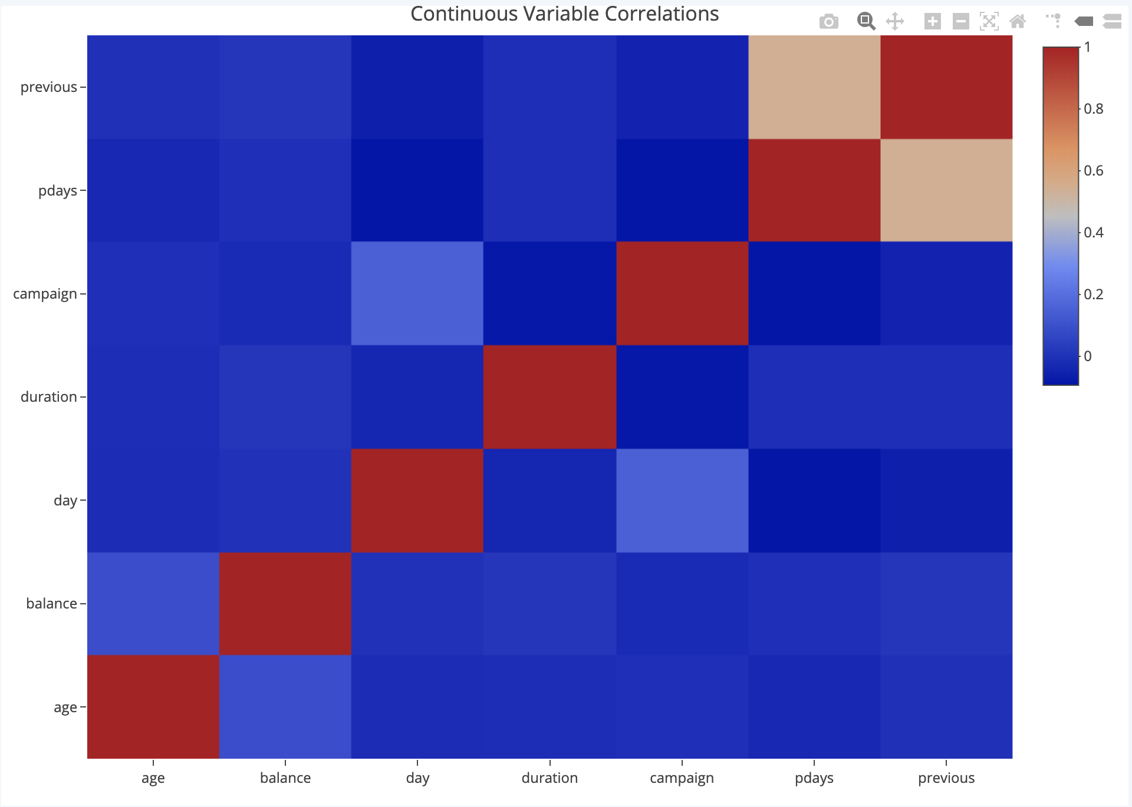
There are no highly correlated continuous variables. “Previous” & “pdays” show the highest correlation.
Continuous Variable Correlations

Slide 11
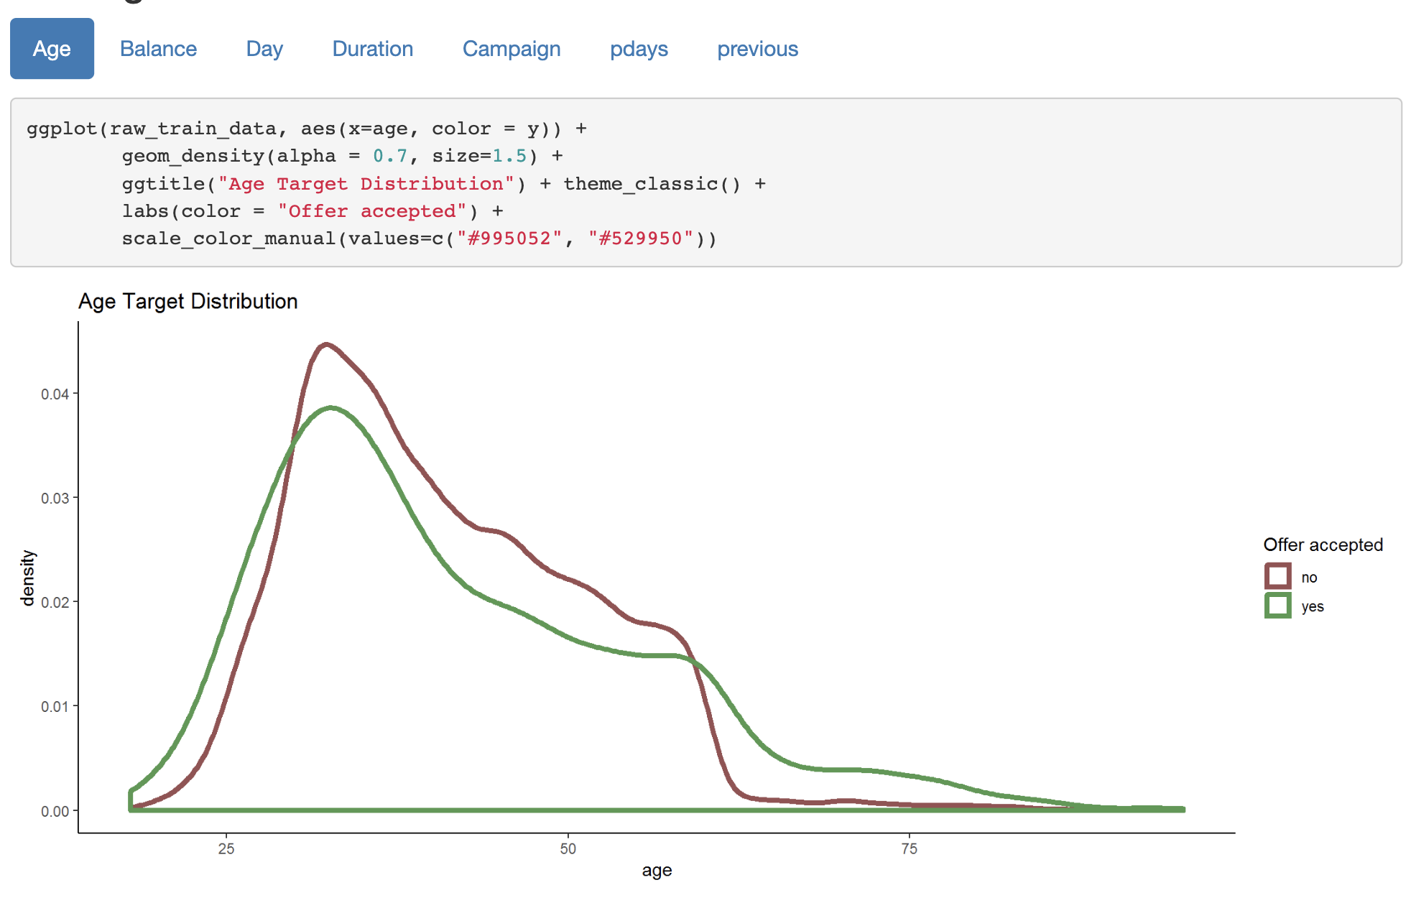
There are lower subsciption for the 30 to 60 age group, and more interest in the young and elderly group.

Slide 12
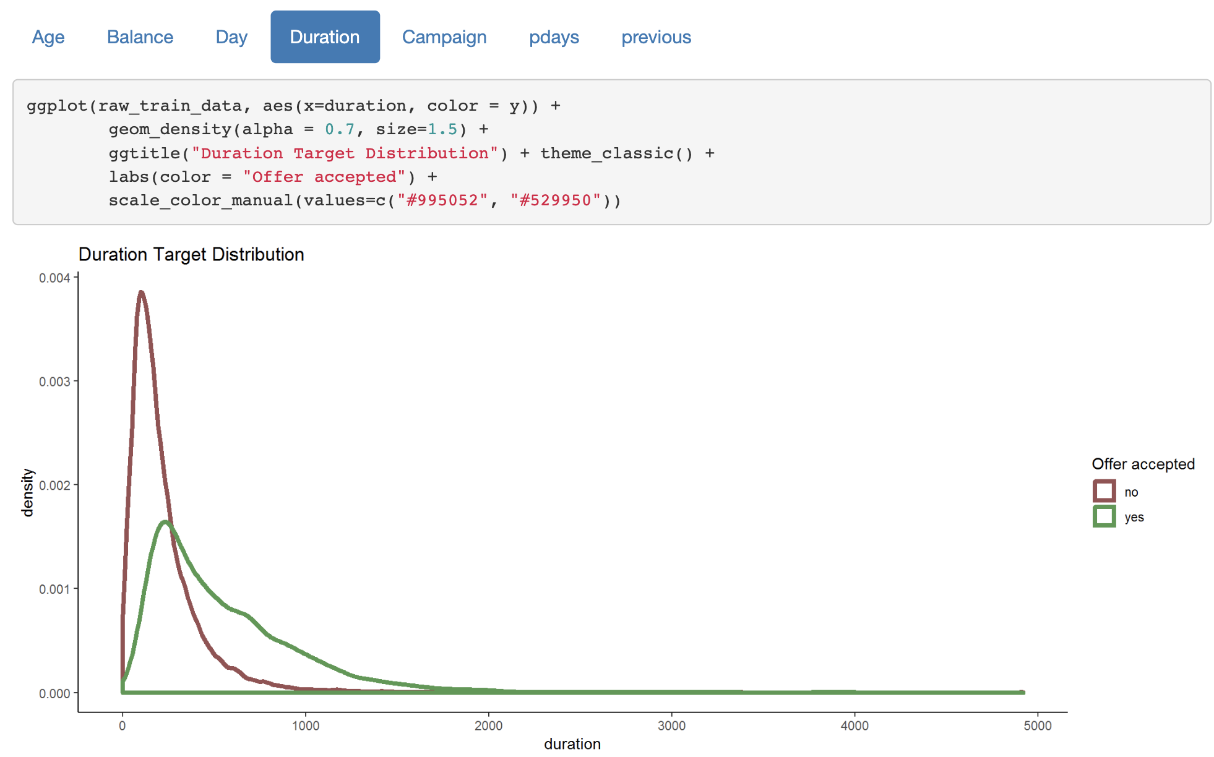
People who rejected the offer tend to have lower call duration, while people who accepted the offer show higher call duration on average.
NOT INCLUDED IN MODELING

Slide 13
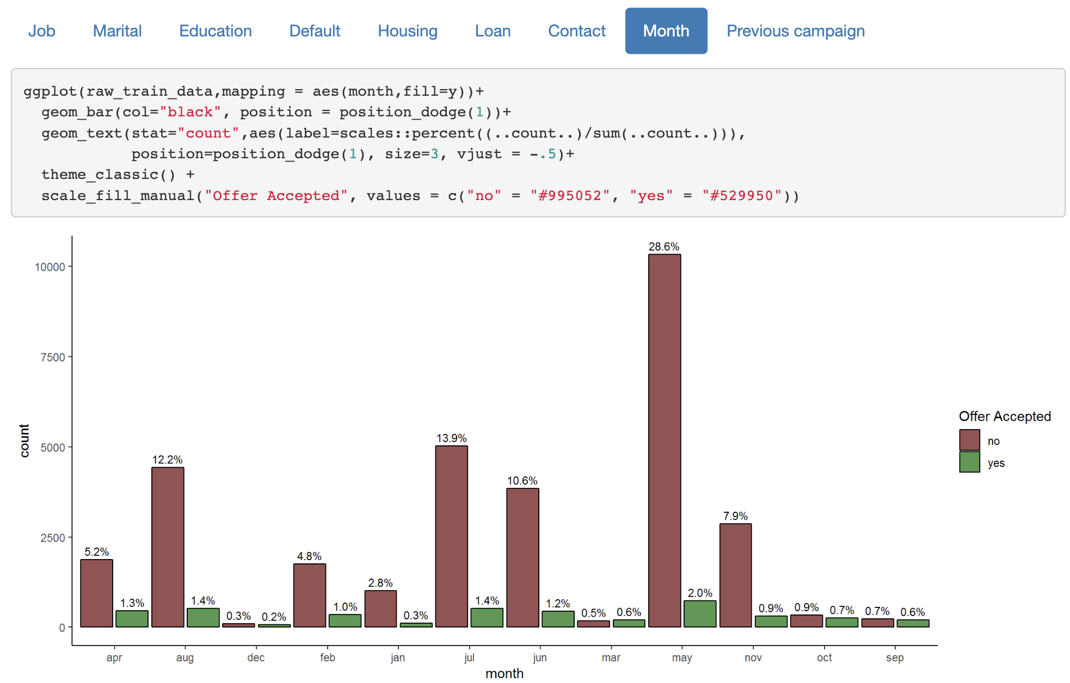
For several months of the year there are significant difference in subcriptions. There seems to be high tendency of offer rejection during summer.

Slide 14
We followed a 5-steps approach to classify customers
1
2
3
4
5
Business Context
Data preparation & exploration
Baseline Model
Feature engineering
Final model

Slide 15



Out of the three algorithms that we used to build the Base Model, XGBoost yields highest sensitivity or highest rate of correctly identified True Positive.
Sensitivity Score
Average CV score: 33.4%
Logistic Regression
Prepared dataset
Average CV score: 45.5%
Random Forest
Average CV score: 47.9%
XG Boost

Slide 16
We followed a 5-steps approach to classify customers
1
2
3
4
5
Business Context
Data preparation & exploration
Baseline Model
Feature engineering
Final model

Slide 17

Modeling Pipeline
Tunning
Train
Build models
Training results
Feature engineering
Test
Model
Test results
Data
Prediction
New

Slide 18
Feature engineering & model tuning
Accepted
SMOTE
Boostrap Target variable
Create variables “Total Number Contact”
Clustering customer related variables
Create weekdays
Numerical combination
Drop Duration
Drop Days
Tuning
Rejected
_{Sensitivity}
34.4%
45.5%
47.9%
_{Precision}
64.5%
63.8%
62.0%
GLM
Random Forest
XG Boost

Slide 19
Due to the imbalance distribution of target variable, we first oversample positive label. This yields significant improvement in performance.
Accepted
SMOTE
Boostrap Target variable
Create variables “Total Number Contact”
Clustering customer related variables
Create weekdays
Numerical combination
Drop Duration
Drop Days
Tuning
Rejected
_{Sensitivity}
+40%
66.2%
+20.7%
-0.4%
74.4%
47.5%
_{Precision}
-23.7%
-10.8%
+0.9%
40.8%
53.0%
62.9%
GLM
Random Forest
XG Boost

Slide 20
While negatively impacting our model, dropping “duration” is necessary as this information is not available to the model at the time of prediction.
Accepted
SMOTE
Boostrap Target variable
Create variables “Total Number Contact”
Clustering customer related variables
Create weekdays
Numerical combination
Drop Duration
Drop Days
Tuning
Rejected
_{Sensitivity}
-37.4%
-32.6%
-27.3%
37.0%
33.6%
20.2%
_{Precision}
-11.7%
-10.7%
-1.4%
29.1%
42.3%
61.5%
GLM
Random Forest
XG Boost

Slide 21
We attempt to drop Days as this is a large factor variable that has low impact on the model. This results in improvement of our models.
Accepted
SMOTE
Boostrap Target variable
Create variables “Total Number Contact”
Clustering customer related variables
Create weekdays
Numerical combination
Drop Duration
Tuning
Drop Days
Rejected
_{Sensitivity}
-1.1%
+0.9%
+1.6%
35.9%
34.5%
21.8%
_{Precision}
+0.3%
+1.1%
+2.1%
29.4%
43.4%
59.4%
GLM
Random Forest
XG Boost

Slide 22

Creation of variable “Total Contact” & clustering customer related variables show improvement in Logistic Model. We stop model XG Boost due to low performance.
Accepted
SMOTE
Boostrap Target variable
Create variables “Total Number Contact”
Clustering customer related variables
Create weekdays
Numerical combination
Drop Duration
Tuning
Drop Days
Rejected
_{Sensitivity}
+2.3%
-1.1%
38.2%
35.6%
_{Precision}
+0.6%
-2.9%
30.0%
40.5%
GLM
Random Forest
XG Boost

Slide 23
We attempt numerical combination to test whether interaction between features help inform the model.
Accepted
SMOTE
Boostrap Target variable
Create variables “Total Number Contact”
Clustering customer related variables
Create weekdays
Drop Duration
Tuning
Drop Days
Numerical combination
Rejected
_{Sensitivity}
-0.3%
-6.4%
37.9%
29.2%
_{Precision}
-0.1%
+6.0%
29.9%
46.5%
GLM
Random Forest

Slide 24
We attempt numerical combination to test whether interaction between features help inform the model.
Accepted
SMOTE
Boostrap Target variable
Create variables “Total Number Contact”
Clustering customer related variables
Create weekdays
Drop Duration
Drop Days
Numerical combination
Tuning
Rejected
_{Sensitivity}
38.2%
_{Precision}
30.0%
GLM

Slide 25
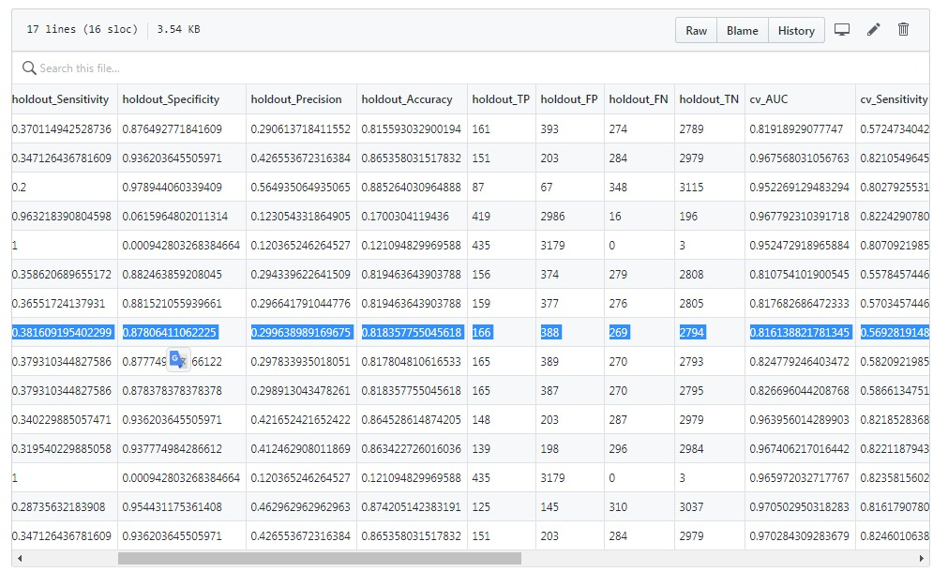
After feature engineering and comparing all the models, we choose the one with the highest sensitivity on our holdout
Accepted
Rejected

Slide 26
We followed a 5-steps approach to classify customers
1
2
3
4
5
Business Context
Data preparation & exploration
Baseline Model
Feature engineering
Final model

Slide 27
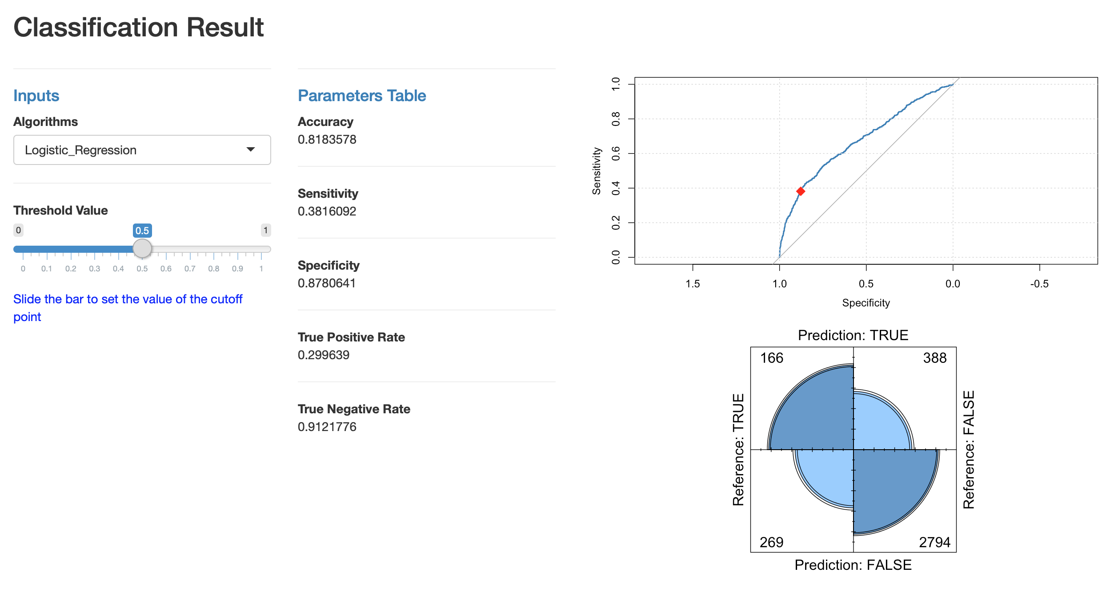
Final Model
38.2 % Sensitivity
Logistic Regression (GLM)

Slide 28
Who are the game changers?
Data Engineer Squad
Data Scientist Fam
Tomas Tello
Theodore Willems
Dan Russotto
Andrew Martinez
Data Visualization Gang
Christine Utendorf
Victor Vu
Celine Khoury

